Slide 1
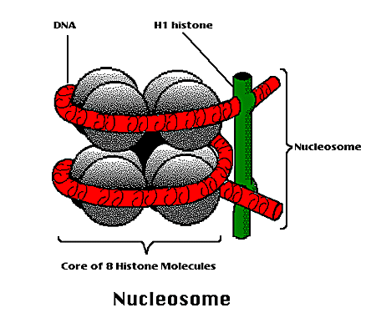


Slide 2
Nucleosome
A nucleosome is a section of DNA that is wrapped around a core of proteins.
Inside the nucleus, DNA forms a complex with proteins called chromatin, which allows the DNA to be condensed into a smaller volume.
When the chromatin is extended and viewed under a microscope, the structure resembles beads on a string.
Each of these tiny beads is a called a nucleosome and has a diameter of approximately 11 nm.

Slide 3
The nucleosome is the fundamental subunit of chromatin.
Each nucleosome is composed of a little less than two turns of DNA wrapped around a set of eight proteins called histones, which are known as a histone octamer.
Each histone octamer is composed of two copies each of the histone proteins H2A, H2B, H3, and H4.
The chain of nucleosomes is then compacted further and forms a highly organized complex of DNA and protein called a chromosome.

Slide 4
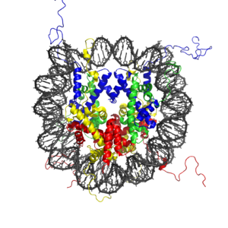
The crystal structure of the nucleosome core particle consisting of H2A , H2B , H3 and H4 core histones, and DNA. The view is from the top through the superhelical axis.

Slide 5
Histones Are the Principal Structural Proteins of Eukaryotic Chromosomes
Histones are relatively small proteins with a very high proportion of positively charged amino acids (lysine and arginine); the positive charge helps the histones bind tightly to DNA (which is highly negatively charged), regardless of its nucleotide sequence.
Histones probably only rarely dissociate from the DNA, and so they are likely to have an influence on any reaction that occurs on chromosomes.
The five types of histones fall into two main groups - the nucleosomal histones and the H1 histones. The nucleosomal histones are small proteins (102-135 amino acids) responsible for coiling the DNA into nucleosomes. These four histones are designated H2A, H2B, H3, and H4. H3 and H4 are among the most highly conserved of all known proteins.

Slide 6
Histones Associate with DNA to Form Nucleosomes, the Unit Particles of Chromatin
Histones play a crucial part in packing this very long DNA molecule in an orderly way into a nucleus only a few micrometers in diameter.
Their role in DNA folding is also important for a second reason.
The long DNA "string" can be broken into nucleosome "beads" by digestion with enzymes that degrade DNA, such as the bacterial enzyme micrococcal nuclease.
After digestion for a short period with micrococcal nuclease, only the DNA between the nucleosome beads is degraded.
The rest is protected from digestion and remains as double-helical DNA fragments.

Slide 7
The nucleosome beads obtained in this way have been crystallized and analyzed by x-ray diffraction. Each is a disc-shaped particle with a diameter of about 11 nm containing two copies of each of the four nucleosomal histones H2A, H2B, H3, and H4. This histone octamer forms a protein core around which the double-stranded DNA helix is wound twice (Figure 1).
In undigested chromatin the DNA extends as a continuous double-helical thread from nucleosome to nucleosome. Each nucleosome is separated from the next by a region of linker DNA, which can vary in length from 0 to 80 nucleotide pairs.
On average, nucleosomes repeat at intervals of about 200 nucleotide pairs (see Figure 1). Thus, a typical eukaryotic gene of 10,000 nucleotide pairs will be associated with 50 nucleosomes, and each human cell with 6 x 10⁹ DNA nucleotide pairs contains 3 x 10⁷ nucleosomes.

Slide 8
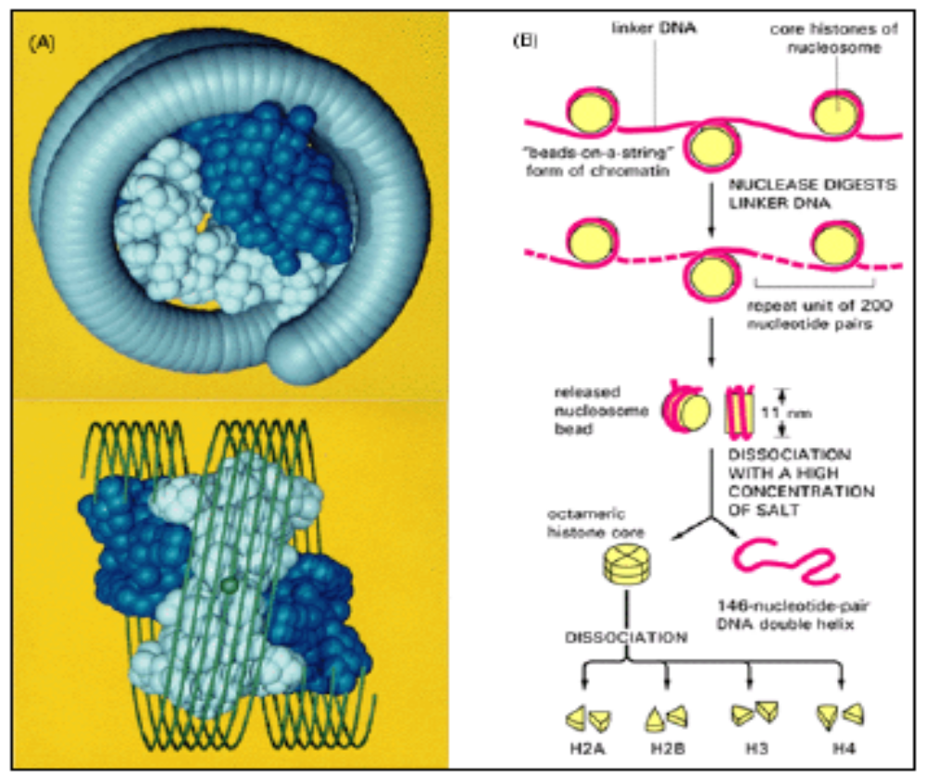
Figure 1. The nature of the nucleosome.

Slide 9
(A) depicts two views of the three-dimensional structure of the histone octamer; the general path of the DNA wrapped around it is indicated by a coiled tube (top) and a series of parallel lines (bottom). Two H2A-H2B dimers (blue) flank an H3-H4 tetramer. The histone octamer is thus composed of two each of histones H2A, H2B, H3, and H4, with a total mass of about 100,000 daltons.
(B) The nucleosome consists of two full turns of DNA (83 nucleotide pairs per turn) wound around an octameric histone core, plus the adjacent "linker DNA". The part of the nucleosome referred to here as the "nucleosome bead" is released from chromatin by digestion of the DNA with micrococcal nuclease. In each nucleosome bead 146 nucleotide pairs of DNA double helix (about 1.8 turns) remain wound around the octameric histone core.

